Slide 1

BUSI3006 Business Ethics Project
Presented by Group Hugo
Ethics Project:
The Sugar Daddy Business
22235337 Yung Hui Ting
22227792 Hui Ho Man
24240494 Leung Tsz Hin
22232583 Lam Pak Hei
21226636 Ng Ka Chun
23213157 Wong Man Kong Rudy

Slide 2

Topic of discussion
1 — Elucidate & Ethical Dilemma
3 —Use of theories
2 — Stakeholders
4 —Reflection

Slide 3
Presented by Yung Hui Ting Angel
Introduction
01

Slide 4
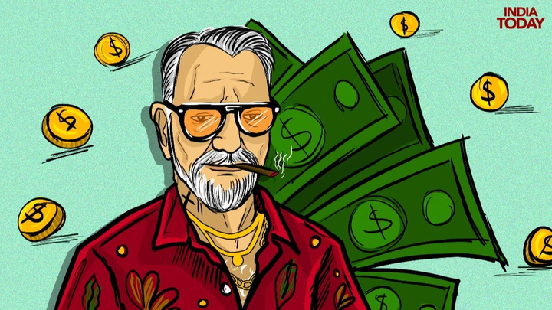
What is
Sugar Daddy Business?
Older, Wealthier individuals (sugar daddies)
Financial support/gifts
Younger individuals (sugar babies)
Exchange for relationship dynamics

Slide 5

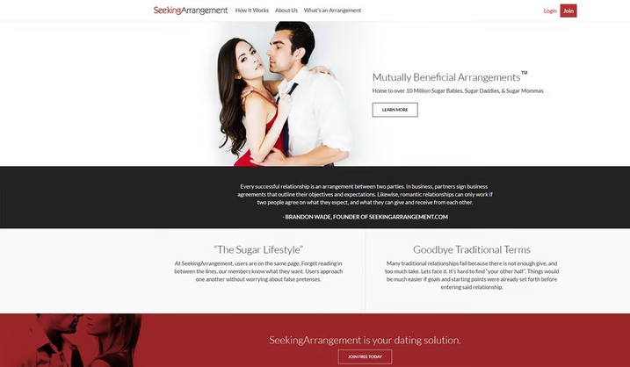
Case Explanation
The Sugarbook: sugar dating website
The founder of Sugarbook Darren Chan:
Men seek beauty while women go for money when it comes to choosing life partners
Sugarbook Users:
Female: aged between 21-32
Male: aged between 30-55
AN INTERVIEW FROM SCMP
HTTPS://WWW.SCMP.COM/WEEK-ASIA/SOCIETY/ARTICLE/2137197/HONG-KONG-SUGAR-BABIES-SINGAPORE-SUGAR-DADDIES-ITS-NOT-ABOUT

Slide 6
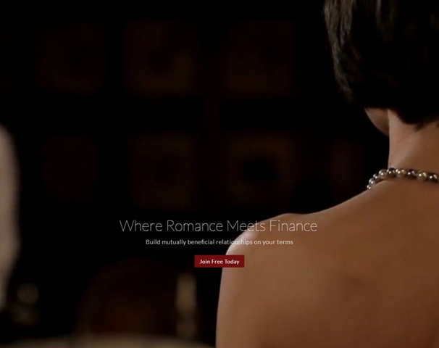
Case Explanation
Case Study:
Lily and her 40-year-old Sugar Daddy
40-year-old Sugar Daddy:
Seek for relationship with young and beautiful ladies
Sugar Baby Lily:
Seek for financial support and high quality of life
e.g. Chanel and Hermès handbag, Cash, business class flight, foreign trip, iPhone, Macbook Pro...
AN INTERVIEW FROM SCMP
HTTPS://WWW.SCMP.COM/WEEK-ASIA/SOCIETY/ARTICLE/2137197/HONG-KONG-SUGAR-BABIES-SINGAPORE-SUGAR-DADDIES-ITS-NOT-ABOUT

Slide 7
Presented by Yung Hui Ting Angel
Ethical Dilemma
01

Slide 8
Society
Right
Wrong
Increased Acceptance
economic pressure of young students
normalization of alternative lifestyles
Moral Judgement
little different to prostitution, often expect more than just companionship
Stigmatization
To against or not?

Slide 9
Sugar Daddy
Right
Wrong
Profiter
Helping Sugar baby with their financial difficulty
Helping Sugar baby with Career support
Exploiter
Financial support to control or manipulate sugar baby
To continue or not?

Slide 10
Sugar Baby
Right
Wrong
Gaining money by their own hard-work
Viewing relationship with Sugar Daddy as a work
Emotionally damaged by what others think of you
health damaged of the risk of having STD（sexually transmitted discease)
To continue or not?

Slide 11
Presented by Wong Man Kong Rudy
Stakeholders
02

Slide 12
Business Owners
Power
Legitimacy
Urgency
Control Over Operations
Market Influence
Business Structure and Compliance
Reputation Management
Adaptation to Market Changes
User Support and Satisfaction

Slide 13
Sugar Baby
Power
Legitimacy
Urgency
Choice and Agency
Influencing Dynamics
Social Perception
Empowerment Narrative
Immediate Financial Needs
Desire for Companionship

Slide 14
Sugar Daddies
Power
Legitimacy
Urgency
Financial Influence
Decision-Making Authority
Social Norms
Business Model Validation
Relationship Dynamics
Market Demand

Slide 15
Presented by Hugo, Donald, Vincent
Use of Theories
03

Slide 16
Normative Ethical Theory
It explains to dictate the morally approriate course of action.

Slide 17

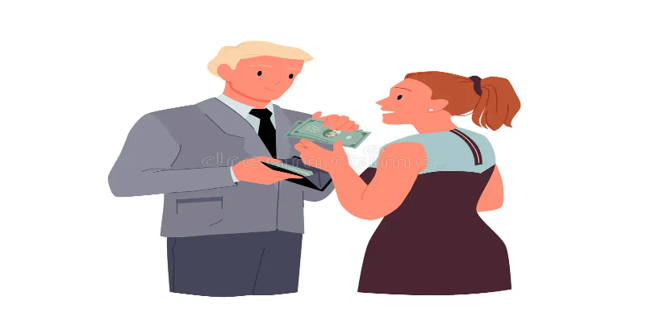


Utilitarianism(Ethical)
Sugar babies & Sugar daddies (Act utilitarianism)
-Both parties benefit mutually
Sugar babies can feel happiness and joy from receiving money from their sugar daddies. Sugar daddies can feel happiness and joy from receiving emotional and sexual support.

Slide 18

Utilitarianism(Unethical)
Society(Rule Utilitarianism)
The Citizens have a stereotype about the sugar daddy business, which is seen as a morally controversial practice.
Blocked the social mobility
The sugar babies are typically less wealthy and younger while sugar daddies are usually more affluent
-Providing a value to the next generation that participating in the sugar baby business
-gain a stable income without having to study hard
-weaken the efforts of the poor to improve social mobility through education

Slide 19

Ethics care
True social Relationship: based on shared values, equality, empathy, support with emotional, trust, and respect.

Slide 20

Ethics care/Feminist ethics(unethical)
The Sugar babies and Sugar daddies
Unhealthy relationship
Their relationship based on transactional
[Sugar daddies holds a position of power due to they pay the money]
-Lack of mutual care & respect

Slide 21

Ethics care/Feminist ethics(unethical)
Society
Unhealthy values for the next generation
-Misleading of the definition of love and relationship with others
-challenging the traditional relationship structure

Slide 22
Descriptive Ethical Theory
It explains the factors driving people to make certain ethical decisions, without passing judgment on the morality of the choices themselves.

Slide 23

Sugar Baby
Economic Pressure:
Many Sugar Babies face financial challenges, like high tuition, rent, and student loans, making financial support from a Sugar Daddy an attractive option.
Material Influence:
In cultures that emphasize material success, Sugar Babies might see these relationships as a pragmatic way to meet financial and lifestyle goals.

Slide 24


Sugar Daddy
Emotional Fulfillment
Some Sugar Daddies seek companionship and a sense of connection they might lack elsewhere.
Lifestyle Compatibility
Financial resources allow Sugar Daddies to support the lifestyle of their partners, potentially attracting Sugar Babies who seek financial stability.

Slide 25
Rights Ethics
Rights Ethics focuses on individuals' basic rights, including freedom of choice, and privacy.

Slide 26
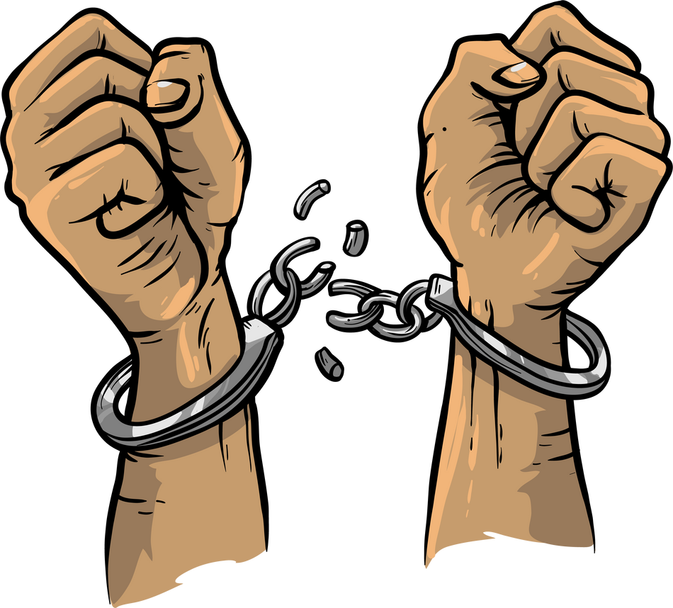
Freedom of Choice
Financial dependency could limit a Sugar Baby’s
freedom to make independent decisions about staying in or leaving the relationship.

Slide 27
Privacy
In some cases, a Sugar Daddy may exercise control over aspects of the Sugar Baby’s personal life, like their social interactions or lifestyle choices. This level of control could infringe on the Sugar Baby’s right to privacy, impacting their personal freedom and sense of independence within the relationship.

Slide 28
Moral Intensity
Issue-related situational influences
It is reasonably new factor, but have significant effect on ethical decision-making.

Slide 29
Moral Intensity
Issue-related situational influences
Magnitude of Consequences
The result of the relationship might be distinct.
Positive: gain of economic support / improvement of living standard
Negative: mental health illness / life exploitation / personal dependency
Temporal Immediacy
Immediate: vanity / promotion of class division
Long-term: social stigma / emotional damage

Slide 30
Moral Intensity
Issue-related situational influences
Social Consensus
It varies between different cultures and eras of society.
Some cultures might accept sugar daddies or even are ideal, but some don’t.
Proximity
A social circle could normalise the phenomenon of “Sugar Daddy”.
It would encourage others to follow without personal consideration.

Slide 31
Reflection

Slide 32

Present by Lam Pak Hei
What is the right thing we should do?

Slide 33

What we really need
to define?
This is not a binary opposition idea
Grey area is exist
Morality varies based on context and individual perspectives.
Insider Trading in past vs now

Slide 34

Typically contemporary ethical theories
Human body right
Being able to make our own decisions about our health, body and sexual life
Meanwhile, many sugar baby influenced by a familiar acquaintance to engage in unprotected sexual activities or even force them to do this
Using relationship of familiar acquaintance contrast with typically contemporary ethical theories

Slide 35


What aspect we should use:
Postmodern ethics
Find out what is right and wrong
Need to depends on the situation
e.g Muslim countries vs Netherlands vs Hong Kong
Pluralism
Combine and respect everything instead of reject
Understand different scenarios

Slide 36
Thank you!

Slide 37
Reference list
Teens Key. (2021). Part-time girl friend handbook. Teens Key.
Amnesty International. (n.d.). My body my rights. Amnesty International

